Slide 1
What is an algorithm?
An algorithm may be broadly defined as a step by step procedure for solving a problem or accomplishing some end. It is a finite sequence of unambiguous, executable steps that ultimately terminate if followed.
Procedure 1
  Make a list of all positive integers
  Arrange this list in descending order (from largest to smallest)
  Extract the first integer from the resulting list
  Stop.
Question: Is Procedure 1 an Algorithm?
Answer: Procedure 1 is not an Algorithm.

Slide 2
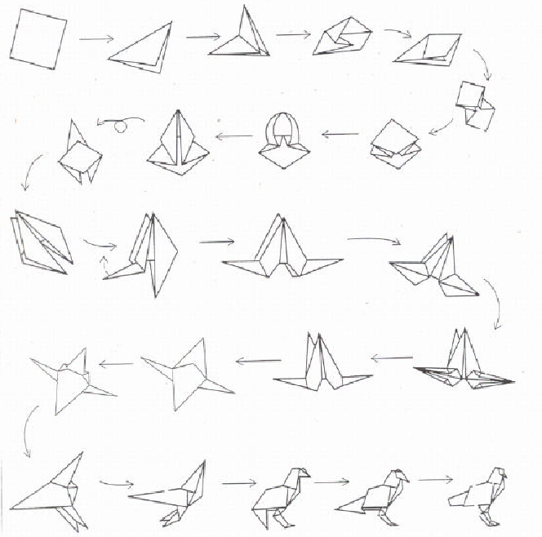
Example in Origami: Algorithm for Making a Bird

Slide 3

Multiple target tracking using a network of UAVs
Algorithms = Problem Solving

Slide 4
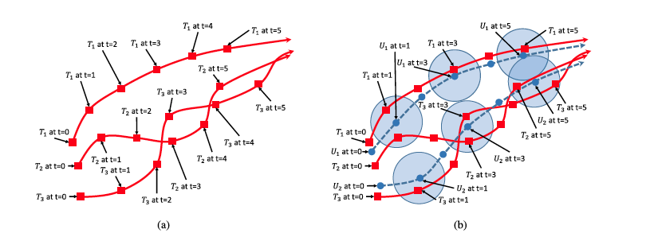
Multiple target tracking using a network of UA

Slide 5

Multiple target tracking using a network of UAVs
Algorithms = Problem Solving

Slide 6

Multiple target tracking using a network of UAVs

Slide 7
Algorithms = Problem Solving
Example in Manufacturing:
Various wafers (tasks) are to be processed in a series of stations. The processing time of the wafers in different stations is different. Once a wafer is processed on a station it needs to be processed on the next station immediately, i.e., there cannot be any wait. In what order should the wafers be supplied to the assembly line so that the completion time of processing of all wafers is minimized?

Slide 8
S1 S2 S8
w1
t₁₁
t₁₂
t₁₈
w2
t₂₁
t₂₂
t₂₈
w3
t₃₁
t₃₂
t₃₈

Slide 9
w1 : t₁₁ = 4, t₁₂= 5;
w2 : t₂₁ = 2, t₂₂ = 4;
w1 :
w2 :
w2:
w2 :
w1:
Completion Time in the first ordering = 13
Completion Time in the second ordering = 11
S1 : 4 | S2 : 5
S1: 2 |  | S2 : 4
S1:2 | S2 : 4
S1: 2 | S2 : 4
S1 : 4 | S2 : 5

Slide 10
Search Space
The solution is somewhere here
  Solution can be found by exhaustive search in the search space
Search space for the solution may be very large
Large search space implies long computation time to find solution (?)
Not necessarily true
Search space for the sorting problem is very large
The trick in the design of efficient algorithms lies in finding ways to reduce the search space

Slide 11
The Central Role of Algorithms in Computer Science
Execution of
Limitations of
Communication of
ALGORITHMS
Discovery of
Representation of

Slide 12
Properties of Algorithms
Finiteness: An algorithm must always terminate after a finite number of steps
Definiteness: Each step must be precisely defined; the actions must be unambiguous
Input: An algorithm has zero or more inputs
  Offline Algorithms: All input data is available before the execution of the algorithm begins
  Online Algorithms: Input data is made available during the execution of the algorithm
Output: An algorithm has one or more outputs
Effectiveness: All operations must sufficiently basic to be done exactly and within a finite length of time by a man using pencil and paper

Slide 13
Evaluating Quality of Algorithms
Often there are several different ways to solve a problem, i.e., there are several different algorithms to solve a problem
What is the “best” way to solve a problem?
What is the “best” algorithm?
How do you measure the “goodness” of an algorithm?
What metric(s) should be used to measure the “goodness” of an algorithm?
  Time
  Space *** What about Power?

Slide 14
Problem and Instance
Algorithms are designed to solve problems
  What is a problem?
    A problem is a general question to be answered, usually processing several parameters, or free variables, whose values are left unspecified. A problem is described by giving (i) a general description of all its parameters and (ii) a statement of what properties the answer, or the solution, required to satisfy.
  What is an instance?
    An instance of a problem is obtained by specifying particular values for all the problem parameters.

Slide 15
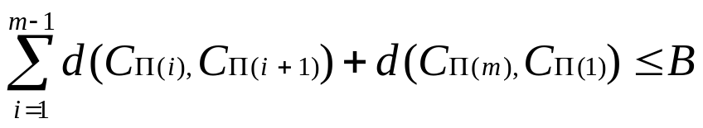
Traveling Salesman Problem
Instance: A finite set C={c₁, c₂, …, c_{m}} of cities, a distance d(c_{i}, c_{j}) є Z⁺ for each pair of cities c_{i}, c_{j} є C and a bound B є Z⁺ (where Z⁺ denotes the positive integers).
Question: Is there a tour of all cities in C having total length no more than B, that is an ordering <c_{π(1)}, c_{π(2)}, …, c_{π(m)}> of C such that,

Slide 16
Measuring efficiency of algorithms
One possible way to measure efficiency may be to note the execution time on some machine
Suppose that the problem P can be solved by two different algorithms A1 and A2.
Algorithms A1 and A2 were coded and using a data set D, the programs were executed on some machine M
A1 and A2 took 10 and 15 seconds to run to completion
Can we now say that A1 is more efficient that A2?

Slide 17
Measuring efficiency of algorithms
What happens if instead of data set D we use a different dataset D’?
  A1 may end up taking more time than A2
What happens if instead of machine M we use a different machine M’?
  A1 may end up taking more time than A2
If one want to make a statement about the efficiency of two algorithms based on timing values, it should read “A1 is more efficient that A2 on machine M, using data set D”, instead of an unqualified statement like “A1 is more efficient that A2”

Slide 18
Measuring efficiency of algorithms
The qualified statement “A1 is more efficient that A2 on machine M, using data set D” is of limited value as someone may use different data set or a different machine
Ideally, one would like to make an unqualified statement like “A1 is more efficient that A2” , that is independent of data set and machine
We cannot make such an unqualified statement by observing execution time on a machine
Data and Machine independent statement can be made if we note the number of “basic operations” needed by the algorithms
  The “basic” or “elementary” operations are operations of the form addition, multiplication, comparison etc

Slide 19
Analysis of Algorithms
Size= n Time Compl Func | 10 | 20 | 30 | 40 | 50 | 60
(A₁) n | .00001 sec
(A₂) n²
(A₃) n³
(A₄) n⁵
(A₅) 2^{n}
(A₆) 3^{n}
.00002
sec
.00003
sec
.00004
sec
.00005
sec
.00006
sec
.0001
sec
.0004
sec
.0009
sec
.0016
sec
.0025
sec
.0036
sec
.001
sec
.008 .027 .064 .125 .216
sec sec sec sec sec
.1 sec
3.2 sec 24.3 sec 1.7 min 5.2 min 13.0 min
.001
sec
1.0
sec
17.9
min
12.7
days
35.7
years
366 centuries
.059
sec
58 6.5 3855 2*10⁸ 1.3*10¹³
min years cents. cents. cents.

Slide 20
Size of Largest Problem Instance Solvable in 1 Hour
Time complexity function | With present computer | With computers 100 times faster | With computer 1000 times faster
n | N₁
n² | N₂
n³ | N₃
n⁵ | N₄
2^{n} | N₅
3^{n} | N₆
100 N₁
1000 N₁
10 N₂
31.6 N₂
4.64 N₃ 10 N₃
2.5 N₄ 3.98 N₄
N₅ + 6.64
N₅ + 9.97
N₆ + 4.19 N₆ + 6.29

Slide 21
Growth of Functions: Asymptotic Notations
O(g(n)) = {f(n): there exists positive constants c and n₀ such that 0<=f(n)<=c * g(n) for all n >= n₀}
Ω(g(n)) = {f(n): there exists positive constants c and n₀ such that 0<=c * g(n)<=f(n) for all n >= n₀}
Q(g(n)) = {f(n): there exists positive constants c₁, c₂ and n₀ such that 0<= c₁ * g(n)<=f(n)<=c₂*g(n) for all n >= n₀}
o(g(n) = {f(n): for any positive constant c>0 there exists a constant n₀ such that 0<=f(n)<c * g(n) for all n >= n₀}
w(g(n)) = {f(n): for any positive constant c>0 there exists a constant n₀ such that 0<=<c * g(n)< f(n) for all n >= n₀}
A function f(n) is said to be of the order of another function g(n) and
is denoted by O(g(n)) if there exists positive constants c andn₀ such
that 0<=f(n)<=c * g(n) for all n >= n₀}

Slide 22
Basic Operations and Data Set
To evaluate efficiency of an algorithm, we decided to count the number of basic operations performed by the algorithm
This is usually expressed as a function of the input data size
The number of basic operations in an algorithm
  Is it dependent or independent of the data set ?

Slide 23
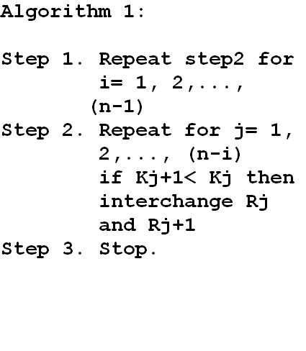
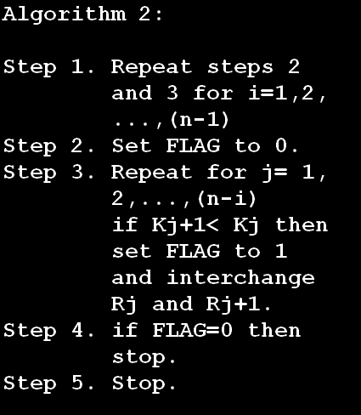
Given a set of records R₁, …, R_{n} with keys k₁, …,k_{n.} Sort the records in ascending order of the keys.

Slide 24
Basic Operations and Data Set
The number of basic operations in an algorithm
  Is it independent of the data set ?
  Is it dependent on the data set?
If the number of basic operations in an algorithm depends on the data set then one needs to consider
  Best case complexity
  Worst case complexity
  Average case complexity
    What does “average” mean?
    Average over what?

Slide 25
Given n elements X[1], …, X[n], the algorithm finds m and j such that m = X[j] = max _{1<=k<=n} X[k], and for which j is as large as possible.
Algorithm FindMax
Step 1. Set j ← n, k ← n – 1, m ← X[n]
Step 2. If k=0, the algorithm terminates.
Step 3. If X[k] <= m, go to step 5.
Step 4. Set j ← k, m ← X[k].
Step 5. Decrease k by 1, and return to step 2

Slide 26
Computational Speed-up and the Role of Algorithms
Moore’s law says that computing power (hardware speed) doubles every eighteen months
How long will it take to have a thousand-fold speed-up in computation, if we rely on hardware speed alone?
  Answer: 15 years
  Expected cost: significant
How long will it take to have a thousand-fold speed-up in computation, if we rely on the design of clever algorithms?
  Thousand-fold speed-up can be attained if currently used O(n⁵) complexity algorithm is replaced by a new algorithm with complexity O(n²) for n=10.
  How long will it take to develop a O(n²) complexity algorithm which does the same thing as the currently used O(n⁵) complexity algorithm?
    Answer: May be as little as one afternoon
    Ingredients needed
      Pencil
      Paper
      A beautiful mind
  Expected cost: significantly less than what will be needed if we rely on hardware alone

Slide 27
Computational Speed-up and the Role of Algorithms
A clever algorithm can achieve overnight what progress in hardware would require decades to accomplish
“The algorithm things are really startling, because when you get those right you can jump three orders of magnitude in one afternoon.”
William Pulleyblank
Senior Scientist, IBM Research

Slide 28






What this class is all about?
What this class is all about? (NOT)

Slide 29
Algorithm Design Techniques
Divide and Conquer
Dynamic Programming
Greedy Algorithms
Backtracking
Branch and Bound
Approximation Algorithms
Probabilistic Algorithms
Mathematical Programming
Parallel and Distributed Algorithms
Simulated Annealing
Genetic Algorithms
Tabu Search

Slide 30
Analysis of Algorithms
Size= n Time Compl Func | 10 | 20 | 30 | 40 | 50 | 60
(A₁) n | .00001 sec
(A₂) n²
(A₃) n³
(A₄) n⁵
(A₅) 2^{n}
(A₆) 3^{n}
.00002
sec
.00003
sec
.00004
sec
.00005
sec
.00006
sec
.0001
sec
.0004
sec
.0009
sec
.0016
sec
.0025
sec
.0036
sec
.001
sec
.008 .027 .064 .125 .216
sec sec sec sec sec
.1 sec
3.2 sec 24.3 sec 1.7 min 5.2 min 13.0 min
.001
sec
1.0
sec
17.9
min
12.7
days
35.7
years
366 centuries
.059
sec
58 6.5 3855 2*10⁸ 1.3*10¹³
min years cents. cents. cents.

Slide 31
Problems and Algorithms for their solution
Problem P
Algorithm 3
Complexity: O(2^{n})
Algorithm 1
Complexity: O(n)
Algorithm 2
Complexity: O(n⁴)

Slide 32
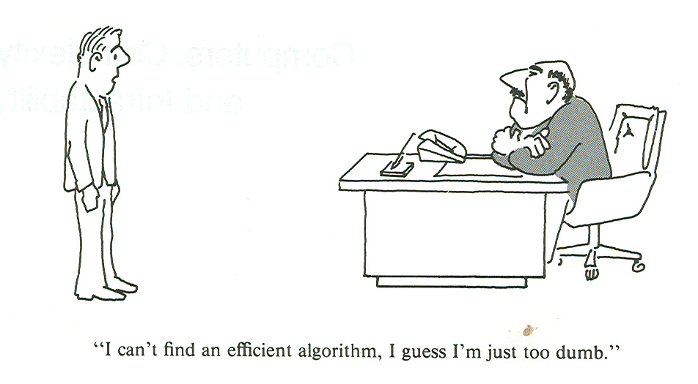
Complexity of a Problem

Slide 33
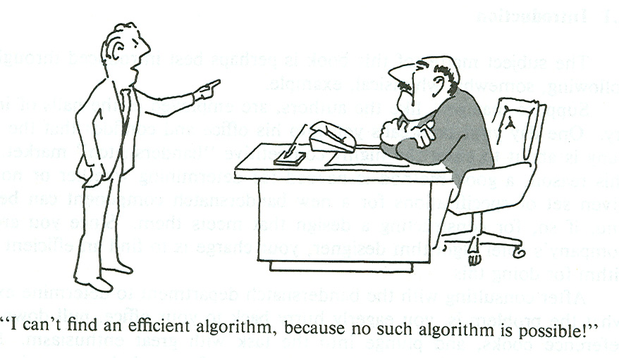

Slide 34
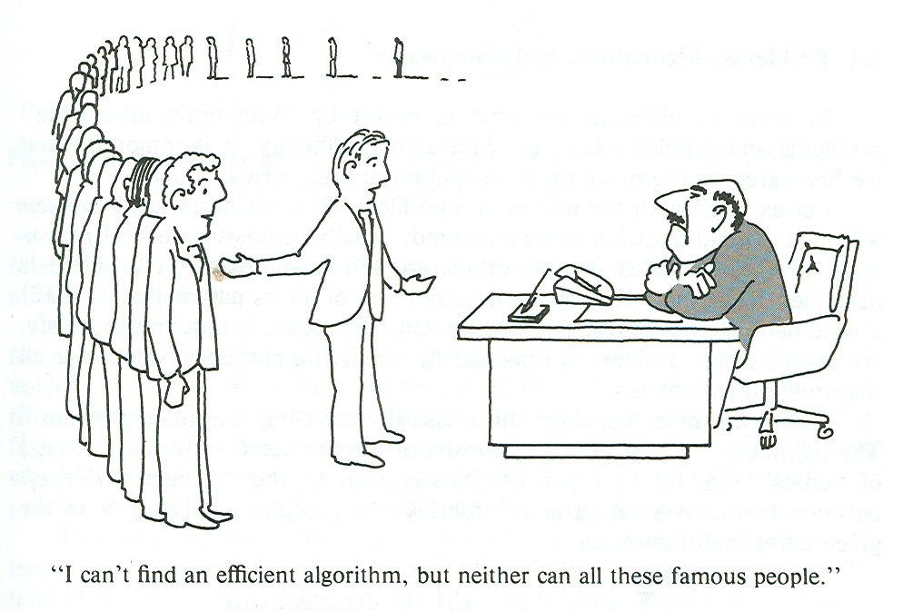

Slide 35
How do you “prove” a problem to be “difficult”?
Suppose that the algorithm you developed for the problem to be solved (after many sleepless nights) turned out to be very time consuming
Possibilities
  You haven’t designed an efficient algorithm for the problem
    May be you are not that great an algorithm designer
    May be you are a better fashion designer
    May be you have not taken CSE 551 Foundations of Algorithms class
  May be the problem is difficult and more efficient algorithm cannot be designed
    How do you know that more efficient algorithm cannot be designed?
    It is difficult to substantiate a claim that more efficient algorithm cannot be designed
    Your inability to design an efficient algorithm does not necessarily mean that the problem is “difficult”
    It may be easier to claim that the problem “probably” is “difficult”
    How do you substantiate the claim that the problem “probably” is “difficult”?
    What if you line up a bunch of “smart” people who will testify that they also think that the problem is difficult?
    Theory of NP-Completeness

Slide 36
How to prove a problem difficult?
Is the approach of lining up a group of famous people really going to work?
Answer: Probably not
Why would a group of famous people be interested in working on your problem?
“If the mountain does not come to Mohammed, Mohammed goes to the mountain”
If the famous people are not interested in working on your problem, you transform their problem into yours.
If such a transformation is possible, you can now claim that if your problem can easily be solved, so can be theirs.
In other words, if their problem is difficult, so is yours.

Slide 37
Theory of NP-Completeness
Complexity of an algorithm for a problem says more about the algorithm and less about the problem
  If a low complexity algorithm can be found for the solution of a problem, we can say that the problem is not difficult
  If we are unable to find a low complexity algorithm for the solution of a problem, can we say that the problem is difficult?
    Answer: No
NP-Completeness of a problem says something about the problem
    Problems may or may not be NP-Complete – not the algorithms

Slide 38
Traveling Salesman Problem
Instance: A finite set C={c₁, c₂, …, c_{m}} of cities, a distance d(c_{i}, c_{j}) є Z⁺ for each pair of cities c_{i}, c_{j} є C and a bound B є Z⁺ (where Z⁺ denotes the positive integers).
Question: Is there a tour of all cities in C having total length no more than B, that is an ordering <c_{π(1)}, c_{π(2)}, …, c_{π(m)}> of C such that,

Slide 39
Problem Transformation – Hamiltonian Cycle Problem
A cycle in a graph G = (V, E) is a sequence <v₁, v₂, …, v_{k}> of distinct vertices of V such that {v_{i}, v_{i+1}} e E for 1 <= i < k and such that {v_{k}, v₁} e E.
A Hamiltonian cycle in G is a simple cycle that includes all the vertices of G.
Hamiltonian Cycle Problem
  Instance: A graph G = (V, E)
  Question: Does G contain a Hamiltonian cycle?

Slide 40
Problem Transformation
Claim: Graph G contains a Hamiltonian Cycle, if and only if there is a tour of all the cities in G’, that has a total length no more than B.
If G has a HC <v₁, v₂, …, v_{n}>, then G’ has a TSP tour of length n = B, because each intercity distance traveled in the tour corresponds to an edge in G and hence has length 1.
If G’ has a TSP tour of length n = B, then each edge e that contributes to the tour must have dist(e) = 1 (because the tour is made up of n edges). It implies that these edges are present in G as well. These set of edges makes up a Hamiltonian Cycle in G.

Slide 41
No-wait Flow-shop Scheduling Problem
S1 S2 S8
w1
t₁₁
t₁₂
t₁₈
w2
t₂₁
t₂₂
t₂₈
w3
t₃₁
t₃₂
t₃₈

Slide 42
Problem Transformation
No-wait Flow-shop Scheduling Problem can be transformed into Traveling Salesman Problem
  How?
  We will see it later
Hamiltonian Cycle problem can be transformed to Traveling Salesman Problem
  How?
  From an instance of the HC Problem, the graph G = (V, E), (|V| = n), construct an instance of the TSP problem as follows: Construct a completely connected graph G’ = (V’, E’) where (|V’| = |V|). Associate a distance with each edge of E’. For each edge e’ e E’, if e’ e E then dist(e’) = 1, otherwise dist(e’) = 2. Set B, a problem parameter of the TSP problem, equal to n.

Slide 43
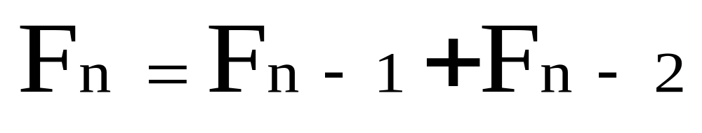
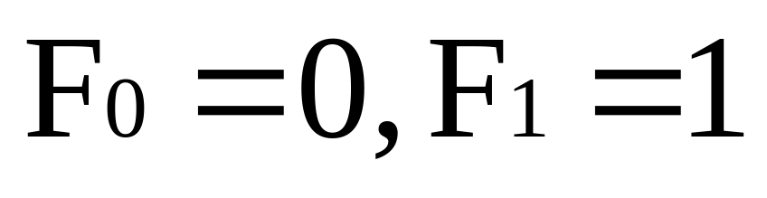
N-th Fibonacci Number

Slide 44
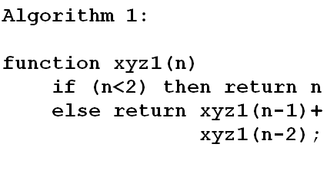
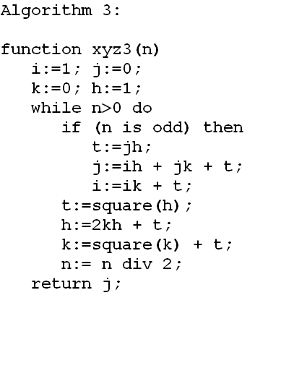
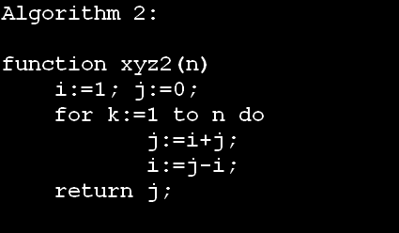
Algorithms and their Complexities

Slide 45
Analysis of Algorithms
Size= n Time Compl Func | 10 | 20 | 30 | 40 | 50 | 60
(A₁) n | .00001 sec
(A₂) n²
(A₃) n³
(A₄) n⁵
(A₅) 2^{n}
(A₆) 3^{n}
.00002
sec
.00003
sec
.00004
sec
.00005
sec
.00006
sec
.0001
sec
.0004
sec
.0009
sec
.0016
sec
.0025
sec
.0036
sec
.001
sec
.008 .027 .064 .125 .216
sec sec sec sec sec
.1 sec
3.2 sec 24.3 sec 1.7 min 5.2 min 13.0 min
.001
sec
1.0
sec
17.9
min
12.7
days
35.7
years
366 centuries
.059
sec
58 6.5 3855 2*10⁸ 1.3*10¹³
min years cents. cents. cents.

Slide 46
Reference Books
For solution of Linear Homogeneous Recurrence Relations with Constant Coefficients: Elements of Discrete Mathematics by C. L. Liu
For Problem Transformation and NP-Completeness: Computers and Intractability by Garey and Johnson

Slide 47
How to Compute Fibonacci Number in O(log n) time?
Transform Fibonacci number computation problem to a matrix chain multiplication problem.
Matrix Chain Multiplication Problem
  P = A₁ * A₂ * A₃ * … * A_{p}, where A_{i} is an n x n matrix.
  A₁ * A₂, where A_{i} is an n x n matrix, can be done in O(n³) complexity.
  If dimensions of A₁ & A₂ are constant, the product A₁ * A₂ can be done in constant time.
  The matrix chain A₁ * A₂ * … * A_{n}, where A₁ = A₂ = … = A_{n}, can be computed in O(log n) time.

Slide 48
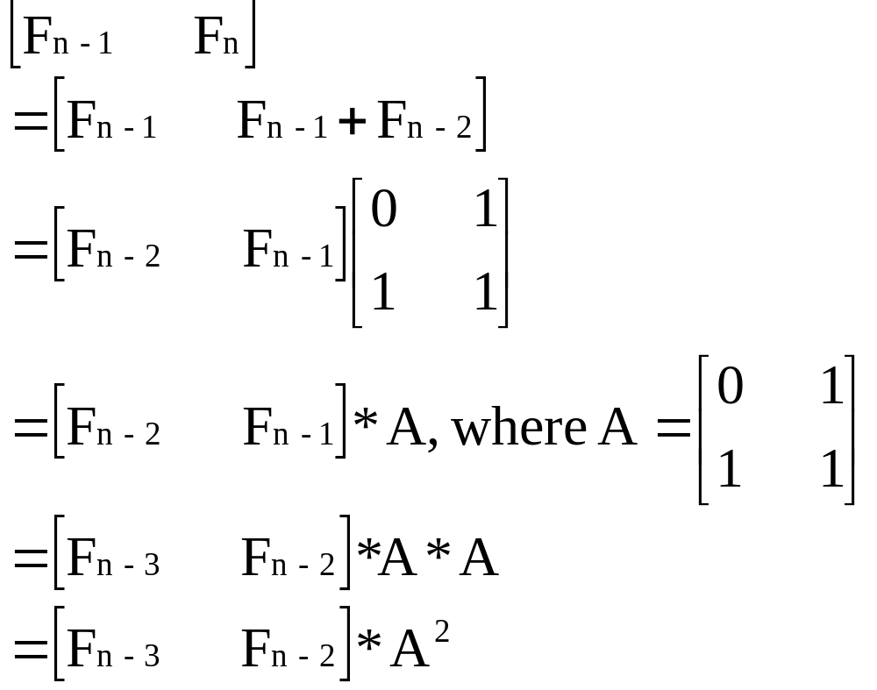
Computation of the n-th Fibonacci Number, F_{n}

Slide 49
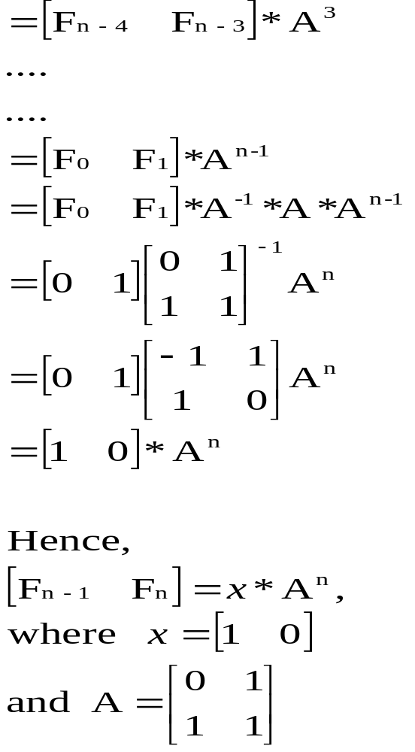
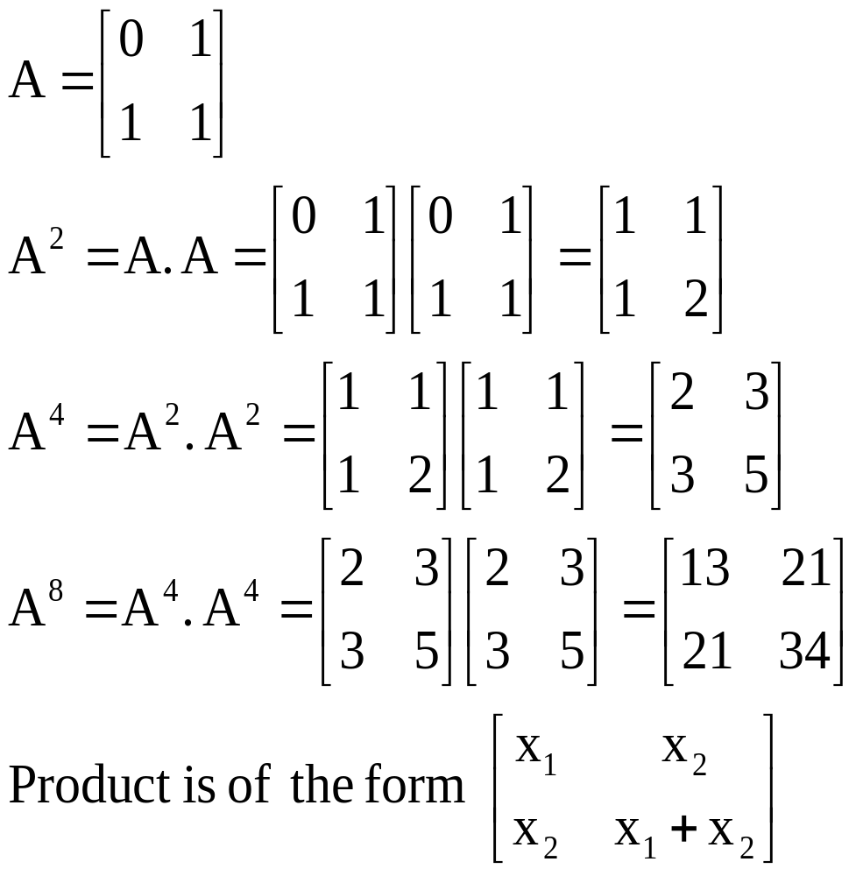

Slide 50
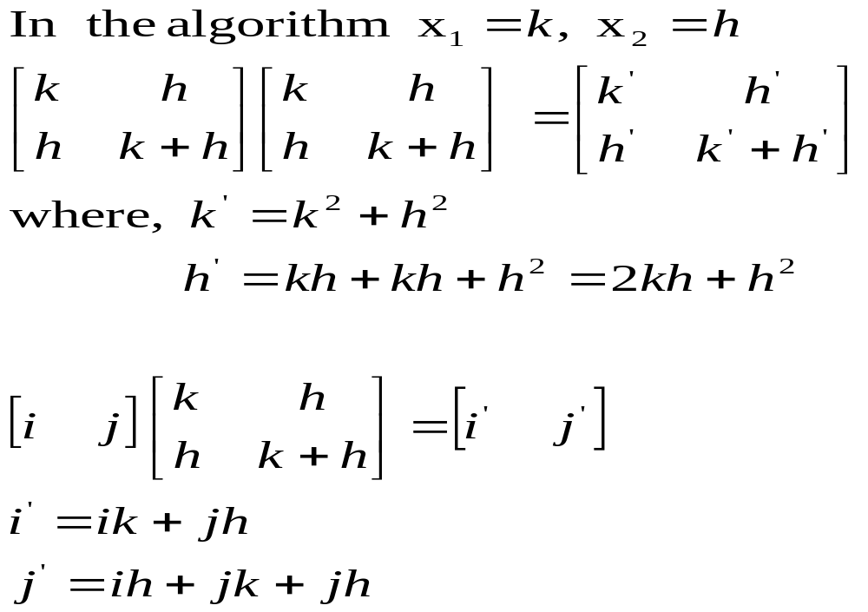

Slide 51
Example 1: Computation of F₇
[F₆ F₇] = x * A⁷
x’’’ = x A⁷
n = 7 | n = 3 | n = 1
x’ = x A A’ = A² | x’’ = x’ . A’ = x A . A² = x A³ A’’ = A^{’ 2} = A⁴ | x’’’ = x’’ . A’’ = x A³ . A⁴ = x A⁷ A’’’ = A^{’’ 2} = A⁸

Slide 52
Example 2: Computation of F₈
[ F₇ F₈] = x . A⁸
x’ = x A⁸
n = 8 | n = 4 | n = 2 | n = 1
A’ = A² | A’’ = A^{’ 2} = A⁴ | A’’’ = A^{’’ 2} = A⁸ | x’ = x . A’’’ = x . A⁸ A’’’’ = A^{’’’ 2}

Slide 53
Algorithms and their Complexities

